Slide 1
TỔNG QUAN VỀ CÔNG NGHỆ VÀ HỆ THỐNG GIẢI TRÌNH TỰ ILLUMINA
Nguyễn Thị Hồng Nhung
MBA.Nguyễn Thuỳ Quốc Hương

Slide 2
What is Next-Generation Sequencing?
1

Slide 3
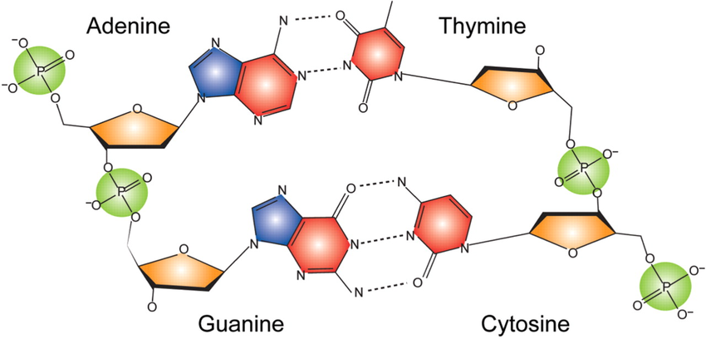
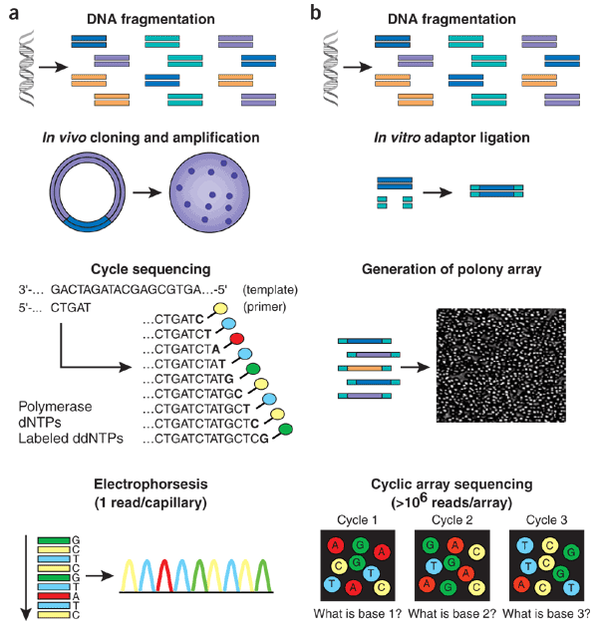
The Ability to Read the Genetic Code
T
G
A
T
A
G
A
G
C
T
C
A
T
C
GTATGCTC
CATACGACGGAC
Basics of DNA sequencing
To be able to read the sequence of DNA (or letters) requires the ability to distinguish between the different nucleotides
Various methods are available:
Some recognize size and shape
The majority use pre-labelled fluorescent nucleotides that only bind to their complementary partner
Sanger-based electrophoresis (1977)
1 read / capillary
96 capillaries / run
1.2Mb / day
NGS Cyclic reads (2007)
4M-20B reads / flow cell
~1500Gb / day
Nucleic acids research 36, 3978–92 (2008)
Nature Biotechnology 26, 1135–1145 (2008), Published online: 9 October 2008

Slide 4

Next-Generation Sequencing
Capillary
NGS
2016 capacity: 10⁶ – 10⁹ reads/array
Shendure, J. et al. Next-generation DNA sequencing. Nature Biotechnology 26 1135 – 1145 (2008)
http://www.illumina.com/systems/sequencing.html

Slide 5
Next-Generation Sequencing
NGS provides “digital” data, each read is analyzed independently and is quantitative
G
AAAACCAGAGTCTAGCACCTTCTCATCAGGAGCA
A
AAACCAGAGTCTAGCACCTTCTCATCAGGAGCA
A
C
AACCAGAGTCTAGCACCTTCTCATCAGGAGCA
A
CG
ACCAGAGTCTAGCACCTTCTCATCAGCAGCA
G
CGT
ACCAGAGTCTAGCACCTTCTCATCAGGAGCA
A
CGT
CCAGAGTCTAGCACCTTCTCATCAGGAGCA
CGTC
A
GAGTCTAGCACCTTCTCATCAGGAGCA
CGTCTGC
G
CTAGCACCTTCTCATCAGGAGCA
CGTCTGCCTTC
A
Massively Parallel Sequencing >100x-1000x
TAGCACCTTCTCATCAGAAGCA
CGTCTGCCTTCG
A
AGCACCTTCTCATCAGGAGCA
CGTCTGCCTTCGC
Overlapping reads are aligned together, resulting in quantitative and high confidence variant calling
G
CCCTTCTCATCAGGAGCA
CGTCTGCCTTCGCTAG
A
ACCTTCTCATCAGTAGCA
CGTCTGCCTTCGCTAG
A
CTTCTCATCAGGAGCA
CGTCTGCCTTCGCTAGGC
G
ATCAGGAGCA
CGTCTGCCTTCGCTAGGCTGACAT
A
ATCAGGAGCA
CGTCTGCCTTCGCTAGGCTGACAT
G
TCAGGAGCA
CGTCTGCCTTCGCTAGGCTGACATC
GAGCA
A
CGTCTGCCTTCGCTAGGCTGACATCGCGG
GAGCA
A
CGTCTGCCTTCGCTAGGCTGACATCGCGG
A
A
CGTCTGCCTTCGCTAGGCTGACATCGCGGGACC
A
A
CGTCTGCCTTCGCTAGGCTGACATCGCGGGACC
G
AAAACCAGAGTCTAGCACCTTCTCATCAGGAGCA
CGTCTGCCTTCGCTAGGCTGACATCGCGGGACC
Notes:
Giải trình tự thế hệ mới cho phép đồng thời nhiều đoạn đọc, nhiều mẫu được giải trình tự cùng nhau.
NGS cung cấp dữ liệu số, mỗi đoạn đọc được phân tích độc lập và định lượng.
Các đoạn đọc chồng lên nhau sẽ được sắp xếp với nhau, kết quả là biến thể được định lượng và có độ tin cậy cao

Slide 6
Illumina Sequencing Workflow
2

Slide 7
Notes:
Quy trình giải trình tự của ILMN gồm 4 bước. Trong đó các bước 2 – 4 sẽ được diễn ra tự động trên tất cả các platform của ILMN

Slide 8
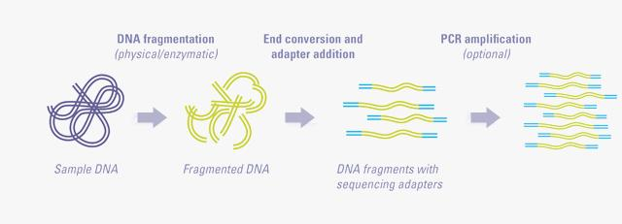
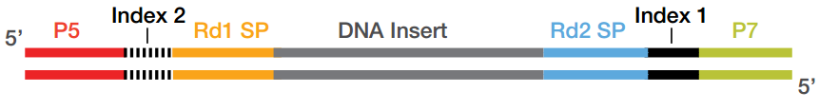
Library Prep is Critical for Successful Sequencing
Library Preparation and Flow Cells
For clustering:
Libraries must have P5 and P7 binding regions on either end of a library
For sequencing:
Libraries must have sequencing primer binding regions
For mixing samples:
Libraries must have a unique index or barcodes sequence

Slide 9
Notes:
Tiếp theo đó là bước tạo Cluster hay còn gọi là tạo khuôn cho quá trình giải trình tự

Slide 10
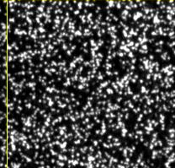
What is a Cluster?
Library Preparation and Flow Cells
Clusters are a group of DNA strands positioned closely together
Each cluster represents thousands of copies of the same DNA strand in a 1–2 micron spot
Cycle 1, G Channel
Single DNA Library Molecule
Amplification
Amplified Clonal Cluster
Notes:
INSTRUCTOR NOTES:
GUIDE NOTES:
[Glossary Icon]
Clusters: A clonal grouping of template DNA bound to the surface of a flow cell. Each cluster is seeded by a single, template DNA strand and is clonally amplified through bridge amplification until the cluster has roughly 1,000 copies. Each cluster on the flow cell produces a single sequencing read.
For example, 1 million clusters on a flow cell would produce 1 million reads.

Slide 11
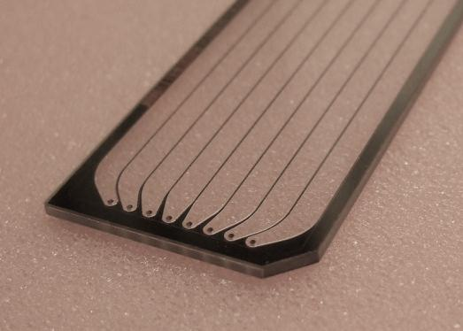
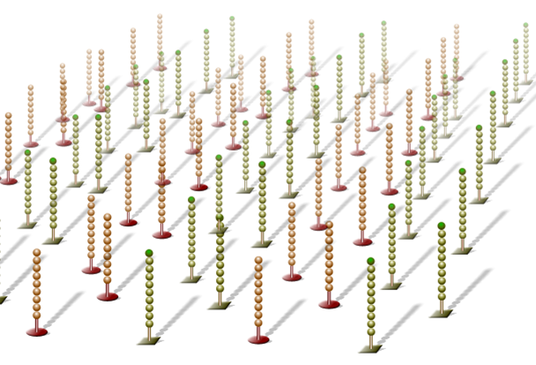
What is a Flow Cell?
Library Preparation and Flow Cells
Cluster generation occurs on a flow cell
A flow cell is a thick glass slide with channels or lanes
Each lane is coated with a lawn of oligos complementary to library adapters
Notes:
Student Guide Notes:
[Glossary Icon]
Flow cell: A glass slide with 1,2, or 8 (depending on instrument platform) physically separated lanes. Each lane is coated with a lawn of surface bound, adapter-complimentary oligos. A single sample or pool of up to 96 multiplexed samples can be run per lane depending on application parameters.

Slide 12

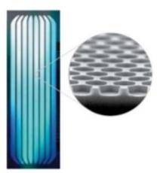

Flow Cell Architecture Random vs Patterned
Library Preparation and Flow Cells
Random Flow Cell
HiSeq 2500, MiSeq, NextSeq, MiniSeq
Randomly spaced clusters
Variable Insert Sizes
Lower Duplication Rates
Patterned Flow Cell
HiSeq 3K/4K/X, NovaSeq, iSeq 100
Defined size and spacing
Increased Cluster density
Simplified imaging

Slide 13
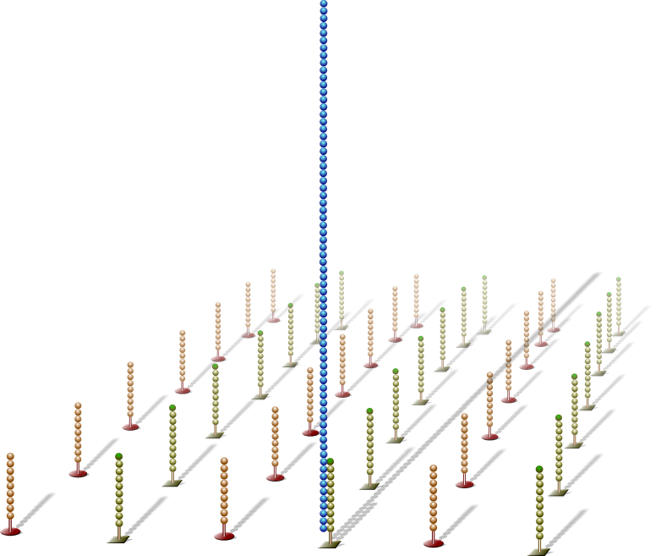
Hybridize Fragment & Extend
Traditional Cluster Generation
Adapter sequence
Single DNA libraries are hybridized to primer lawn
Bound libraries are then extended by polymerases
Surface of flow cell coated with a lawn of oligo pairs
3’ extension
Notes:
Use for Random Flow Cell only (Hide for NovaSeq, HiSeq 3k/4k, and iSeq Customers)
Schematic representation of cluster generation process

Slide 14
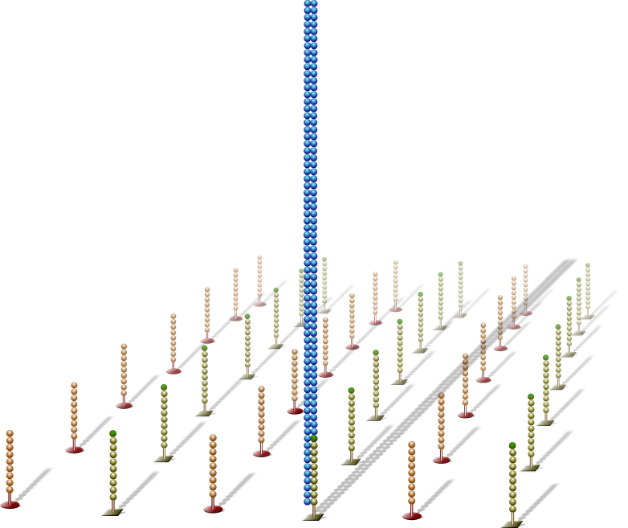
Denatured Double-Stranded DNA
Traditional Cluster Generation
Newly synthesized strand
Double-stranded molecule is denatured
Original template
Original template washed away
discard
Newly synthesized strand is covalently attached to flow cell surface
Notes:
Use for Random Flow Cell only (Hide for NovaSeq, HiSeq 3k/4k, and iSeq Customers)

Slide 15
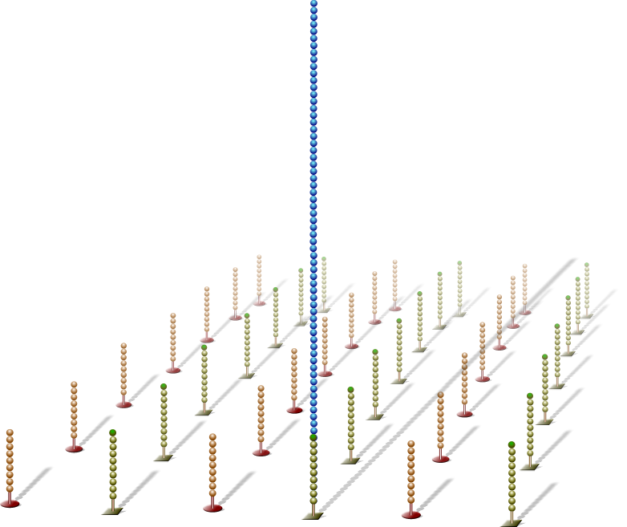
Single-Stranded DNA
Traditional Cluster Generation
NOTE:
Single molecules bind to flow cell in a random pattern
Notes:
Use for Random Flow Cell only (Hide for NovaSeq, HiSeq 3k/4k, and iSeq Customers)

Slide 16
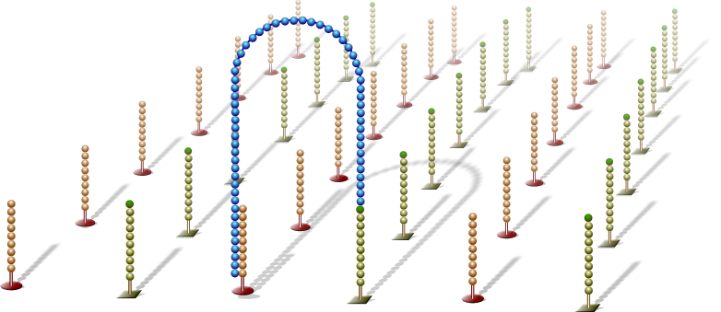
Bridge Amplification
Traditional Cluster Generation
Single-stranded molecule flips over and forms a bridge by hybridizing to adjacent, complementary primer
Hybridized primer extends by polymerases
Notes:
Use for Random Flow Cells Only (Hide for NovaSeq, HiSeq 3k/4k, and iSeq Customers)

Slide 17
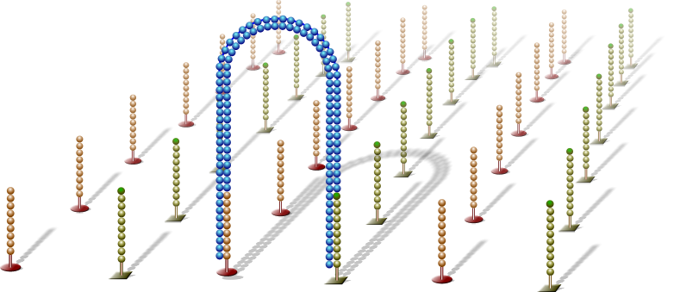
Bridge Amplification
Traditional Cluster Generation
Double-stranded bridge is formed
Notes:
Use for Random Flow Cells Only (Hide for NovaSeq, HiSeq 3k/4k, and iSeq Customers)

Slide 18
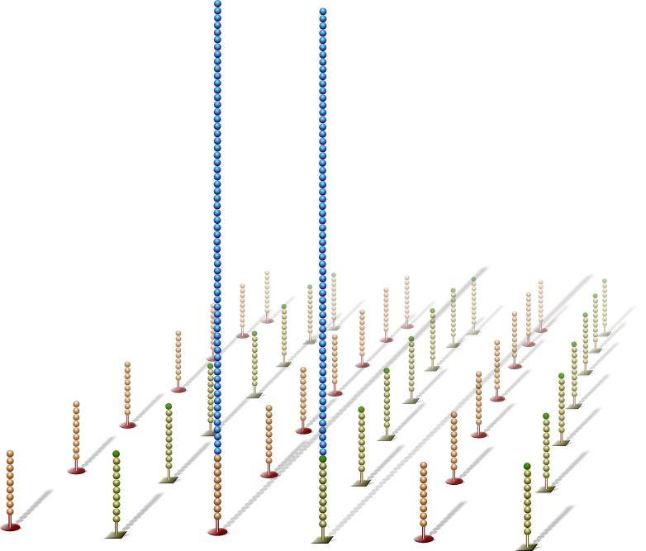
Denature Double-Stranded Bridge
Traditional Cluster Generation
Double-stranded bridge is denatured
Result:
Two copies of covalently bound single-stranded templates
Notes:
Use for Random Flow Cells Only (Hide for NovaSeq, HiSeq 3k/4k, and iSeq Customers)
Instructor’s Script/additional information-
Result:
Reverse complementary DNA strands bound by their 5‘ end to the flow cell

Slide 19
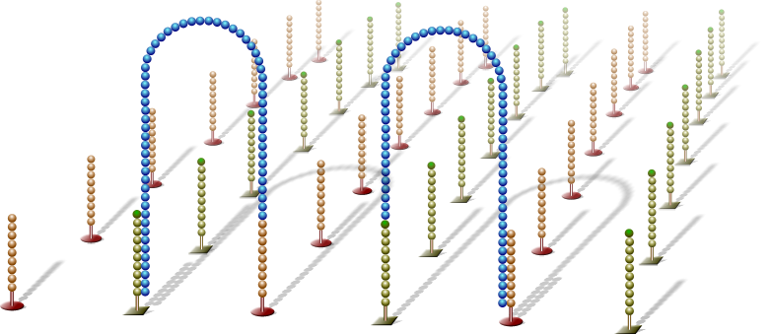
Bridge Amplification
Traditional Cluster Generation
Single-stranded molecules flip over to hybridize to adjacent primers
Hybridized primer extends by polymerase
Notes:
Use for Random Flow Cells Only (Hide for NovaSeq, HiSeq 3k/4k, and iSeq Customers)

Slide 20
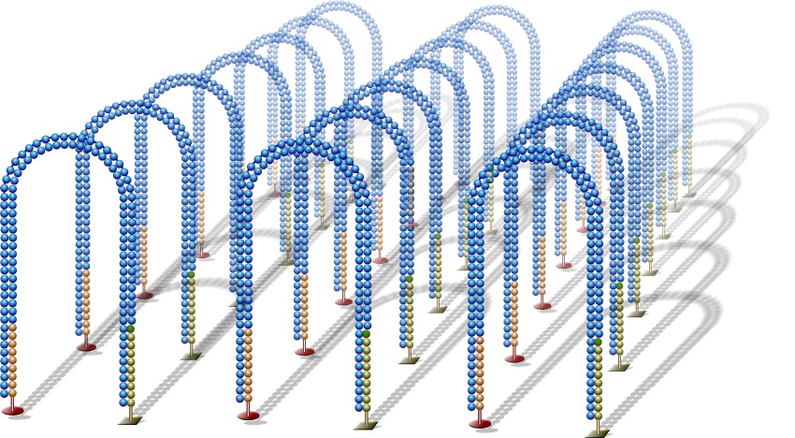
Bridge Amplification
Traditional Cluster Generation
Bridge amplification cycle is repeated until multiple bridges are formed
Notes:
Use for Random Flow Cells Only (Hide for NovaSeq, HiSeq 3k/4k, and iSeq Customers)

Slide 21
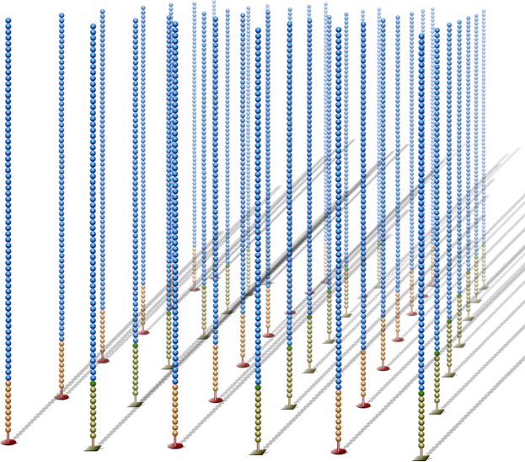
Linearization
Traditional Cluster Generation
dsDNA bridges are denatured
Notes:
Use for Random Flow Cells Only (Hide for NovaSeq, HiSeq 3k/4k, and iSeq Customers)

Slide 22
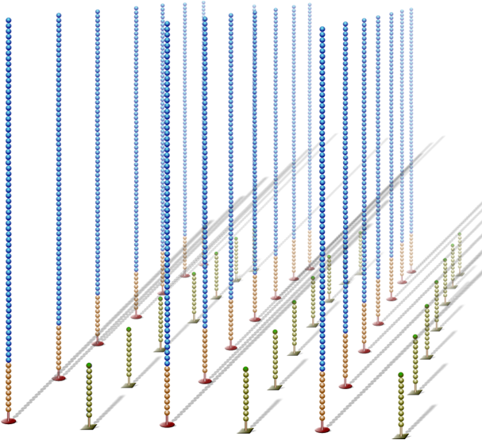
Reverse Strand Cleavage
Traditional Cluster Generation
Reverse strands are cleaved and washed away, leaving a cluster with forward strands only
Notes:
Use for Random Flow Cells Only (Hide for NovaSeq, HiSeq 3k/4k, and iSeq Customers)
Instructor’s Notes:
Bound P5 adapter strands are cleaved and washed away, leaving a cluster with identical strands only. The strands that remain on the flow cell that create the cluster are bound to the flow cell by the 5‘ end of P7 adapter

Slide 23
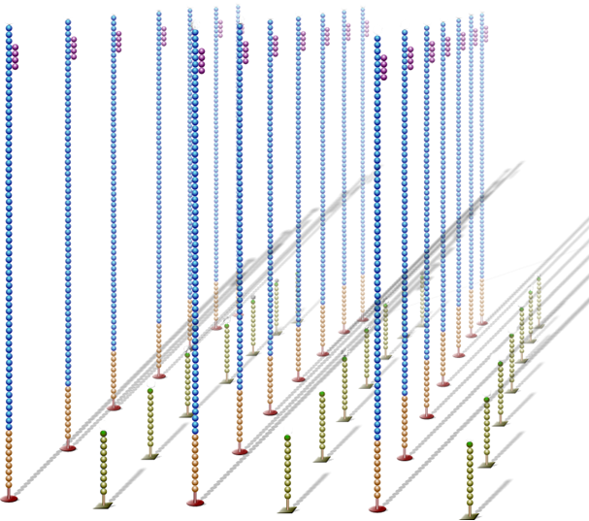
Read 1 Primer Hybridization
Traditional Cluster Generation
Sequencing primer
Sequencing primer is hybridized to adapter sequence
Notes:
Use for Random Flow Cells Only (Hide for NovaSeq, HiSeq 3k/4k, and iSeq Customers)

Slide 24
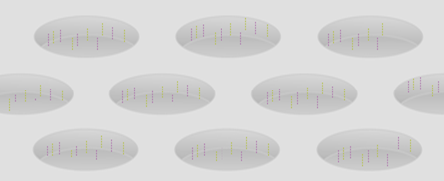
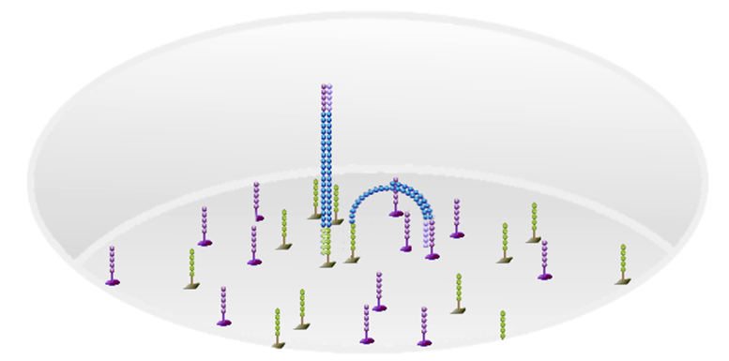
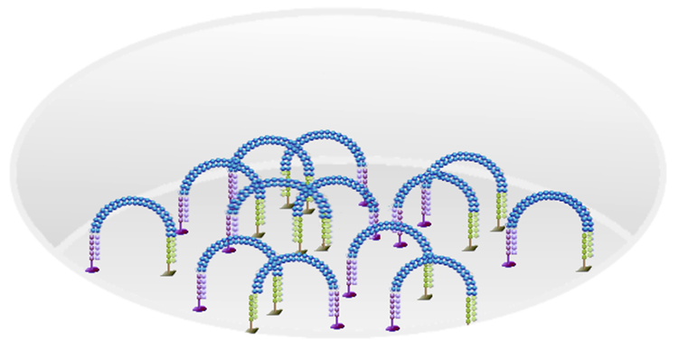
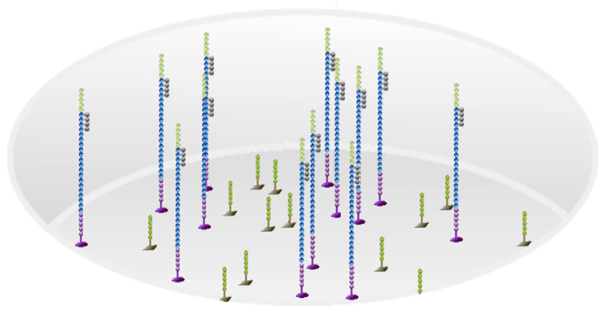
Pattern Flow Cell and ExAmp Technology
ExAmp Cluster Generation
Wells contain grafted oligos
Libraries hybridize and bridge
Multiple cycles of amplification
Ready for Sequencing
Notes:
Use for Patterned Flow Cells Only (Hide for NextSeq, MiSeq, MiniSeq Customers)
Instructor’s Notes:
Can use this slide as an overview of ExAmp/patterned flow cells if customer is familiar with SBS details or if they don’t need to know what is happening at each step of Cluster generation).

Slide 25
Notes:
Use for all Platforms

Slide 26

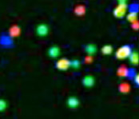
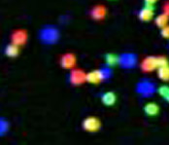
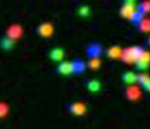



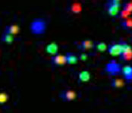
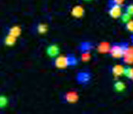
Sequencing Sequencing-by-Synthesis (SBS)
3’
DNA (0.01-1.0 μg)
Single molecule array
5’
A
T
C
G
T
G
T
A
G
C
C
A
G
A
T
G
C
A
A
C
T
C
G
C
G
C
A
T
C
G
A
A
5’
Library Preparation
Cluster Growth
Sequencing
1
2
3
4
5
6
7
8
9
T G T A C G A T …
Image Acquisition
Base Calling

Slide 27
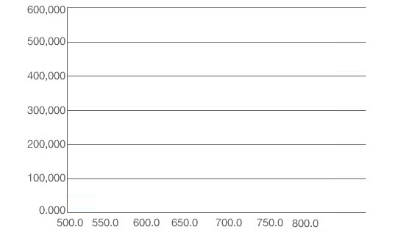
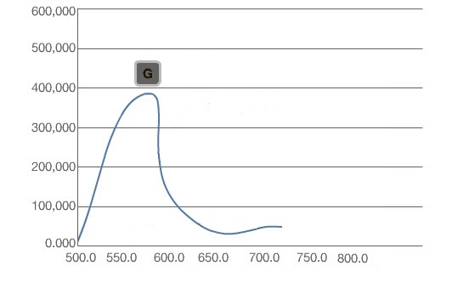
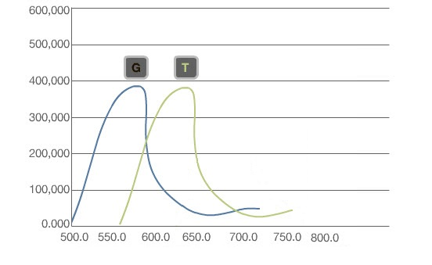
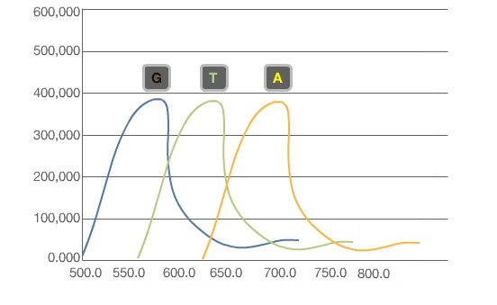
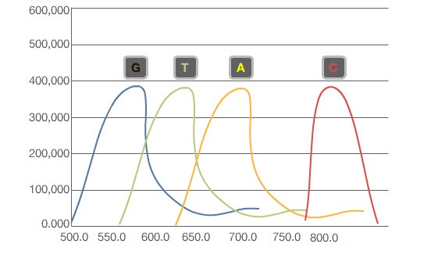
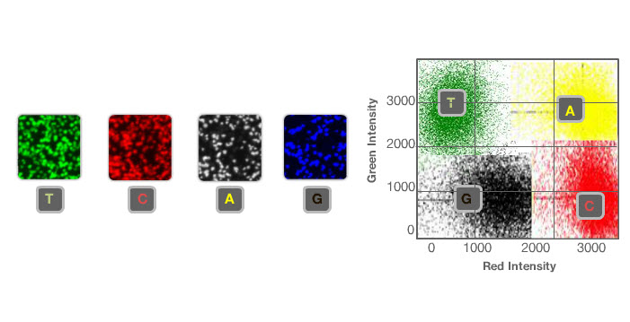
Four Channel SBS Chemistry: HiSeq, MiSeq
Sequencing by Synthesis
Each of the four DNA bases emits an intensity of a unique wavelength
Collects four images:
During each cycle, each cluster appears in only one of four images

Slide 28
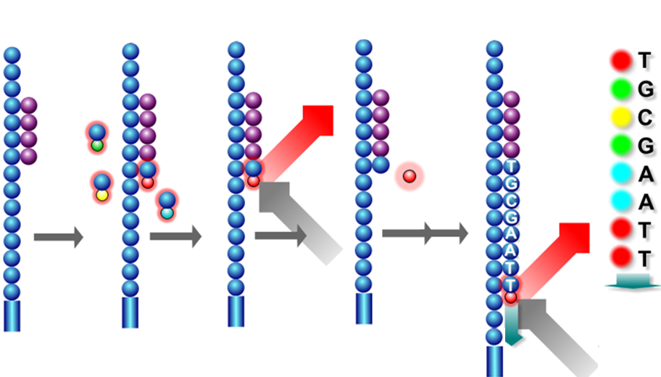

A Closer Look At 4-Dye Chemistry Four channel chemistry
Sequencing
Sequencing by Synthesis
G
T
T
T
T
A
C
A
Add 4 Fl-NTP’s + Polymerase
Incorporated FI-NTP excited
then imaged (4 images/cycle)
Terminator & fluorescent dye cleaved from FI-NTP
X # of bp in read

Slide 29
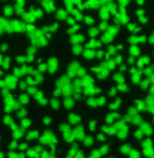
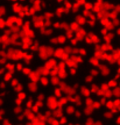
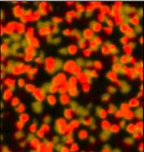

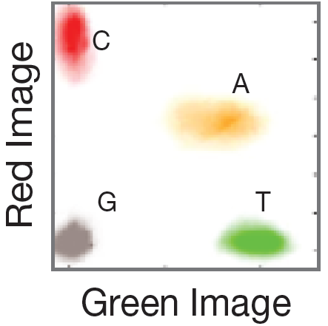
Two Channel SBS Chemistry: NextSeq 550, MiniSeq, NovaSeq
Sequencing
Sequencing by Synthesis
Notes:
Use for all Platforms, unless not relevant for customer
Instructor’s Notes:
Newer/Faster chemistry is Two Channel…
Red emission filter: 580+/-27
Green emission filter: 709+/-23

Slide 30
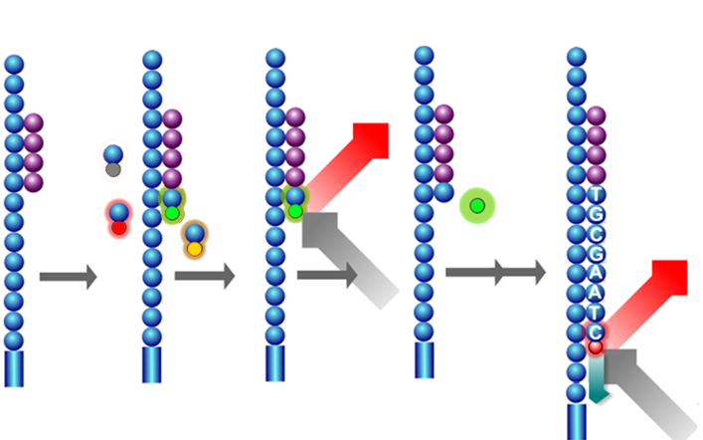

A Closer Look At 2-Dye Chemistry Two channel chemistry
Sequencing
Sequencing by Synthesis
G
T
T
T
C
A
Add 3 Fl-NTP’s & nonFl-NTP + Polymerase
Incorporated FI-NTPs excited
then imaged (2 images/cycle)
Terminator & fluorescent dye cleaved from FI-NTP
X # of bp in read
Notes:
Use for all Platforms, unless not relevant for customer

Slide 31
One-Channel SBS Chemistry iSeq 100
Sequencing
Sequencing by Synthesis
SBS Chemistry combined with Complementary Metal-oxide-semiconductor (CMOS) technology
The system uses a patterned flow cell with nanowells fabricated over a CMOS chip
Each sequencing cycle has two chemistry steps in order to determine bases
Two images are captured within one cycle of sequencing run
Based on the signal pattern across two images, base calls can be determined
Intensities extracted from one image and compared to a second image result in four distinct populations, each corresponding to a nucleotide.
For Research Use Only. Not for use in diagnostic procedures.
‹#›
Notes:
Use for all Platforms, unless not relevant for customer
Instructor’s Notes:
One-channel SBS chemistry-
features two chemistry steps and two imaging steps per sequencing cycle using
nucleotides that can be labeled or unlabeled depending on the chemistry step.
>ExAmp chemistry ensures that only one cluster form in each nanowell
>CMOS sensor embedded in the flow cell for simple and fast detection

Slide 32
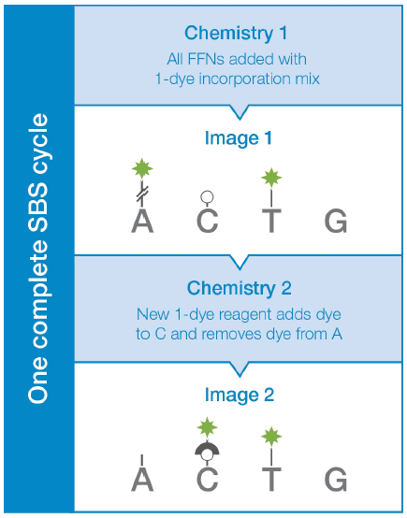

A Closer Look At 1-Dye Chemistry One channel chemistry
Sequencing
Sequencing by Synthesis
One Sequencing Cycle
A
+
T
C
T
G
G
Incorporation
Imaging
Chemistry
Imaging
Incorporation
First Image captured
Second Chemistry Step
Second Image captured
X # of bp in read
Notes:
Use for all Platforms, unless not relevant for customer
Instructor’s Notes:
In one-channel chemistry, adenine has a removable label
and is labeled in the first image only. Cytosine has a linker group that
can bind a label and is labeled in the second image only. Thymine has
a permanent fluorescent label and is therefore labeled in both
images, and guanine is permanently dark (unlabeled). Nucleotides
are identified by analysis of the signal pattern across both images.

Slide 33
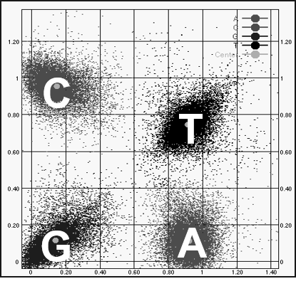
Sequencing by Synthesis with CMOS Detection One channel chemistry
Sequencing
Sequencing by Synthesis
The iSeq 100 System uses one-dye sequencing, which requires one dye and two images to encode data for the four bases
Base | Image 1 | Image 2
T | ON | ON
A | ON | OFF
C | OFF | ON
G | OFF | OFF
C
Image 2
Intensity
T
G
A
Image 1
Intensity
Notes:
Use for all Platforms, unless not relevant for customer

Slide 34
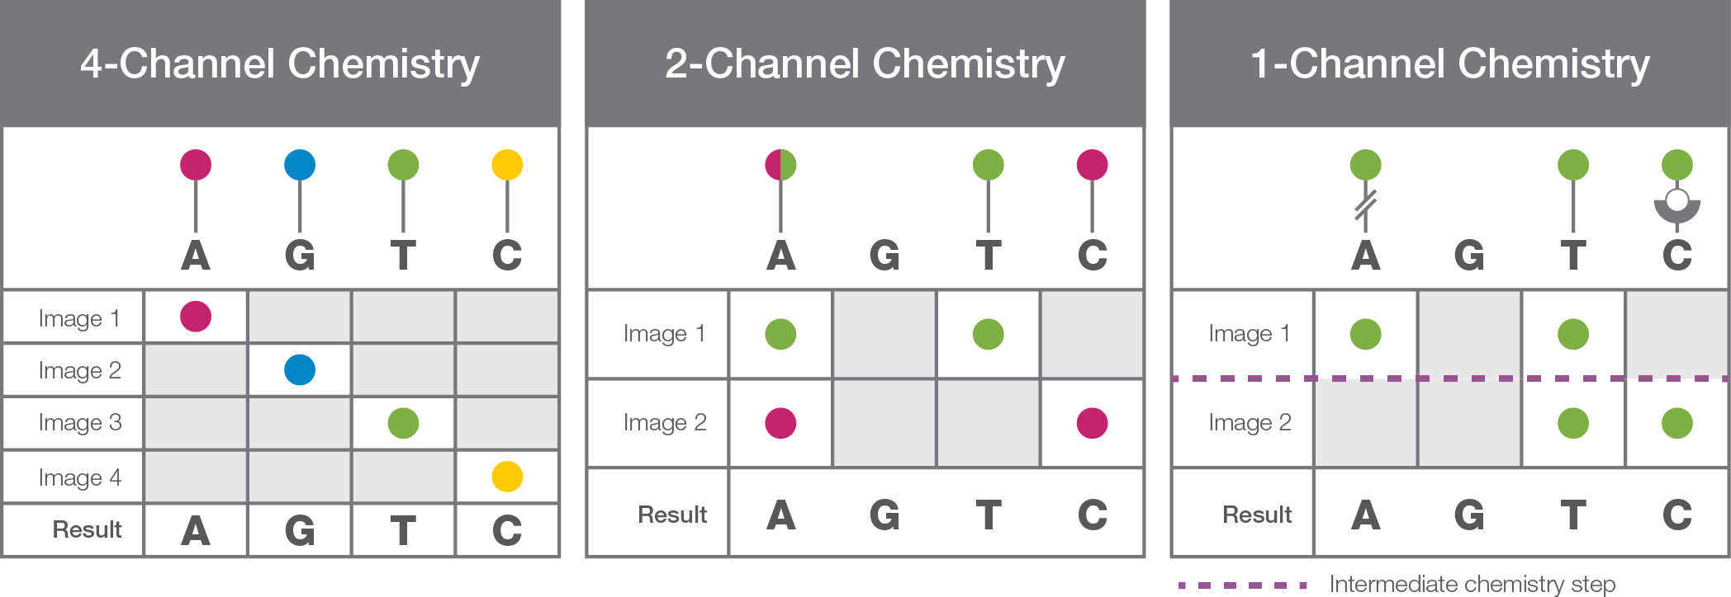
Illumina Chemistry Comparison
Sequencing
Sequencing by Synthesis
Four-channel SBS
Bases are identified using four different fluorescent dyes, one for each base and four images per sequencing cycle
Two-channel SBS
Simplified nucleotide detection by using two fluorescent dyes and two images to determine all four base calls
One-channel SBS
System uses a patterned flow cell with nanowells fabricated over a CMOS chip to determine base calls using only two images
Notes:
Use for all Platforms
Instructor’s Notes:
Four, Two, and One-Channel Chemistry—Four-channel chemistry uses a mixture of nucleotides labeled with four different fluorescent dyes. Two-channel
chemistry uses two different fluorescent dyes, and one-channel chemistry uses only one dye. The images are processed by image analysis software to determine
nucleotide identity.
Reference Illumina CMOS Chip and One-Channel SBS Chemistry comparison

Slide 35
Benefits of SBS Technology
Robust Performance and Data Quality
SBS chemistry delivers the highest yield of error-free reads¹, enabling robust base calling across the genome.
Proven Base Calling Accuracy
SBS produces the highest percentage of sequenced bases over Q30 - a quality score indicating a 0.1% probability that a base was called incorrectly.
Unbiased Coverage Across Genome
SBS uses base-by-base, reversible-terminator chemistry, which virtually eliminates the homopolymer errors seen in ion-semiconductor or pyrosequencing technologies²
High-Quality Alignment with Paired-End Sequencing
SBS allows for paired-end sequencing —sequencing DNA library fragments from both ends, which generates high-quality sequence data.
Cost-Effective for Any Throughput or Scale
Based on a comparison of the top 3 industry-leading NGS platforms. Data calculations on file. Illumina, Inc. 2016.
Ross MG, Russ C, Costello M, et al. Characterizing and measuring bias in sequence data. Gen Biol 2013;14:R51

Slide 36
Notes:
Use for all Platforms

Slide 37
Data Analysis
Sequencing reads aligned to a reference genome
CGATTAGTAC
ACTCGATTAG
ACGGGCTCGA
ACGACGGACT
Reference Sequence
CATACGACGGACTCGATTAGTACTCGTA
Variant/genotype calling
20bp region
6bp @ 1X
8bp @ 2X
6bp @ 3X
Average = 2X
Annotation & filtering
Functional effect

Slide 38
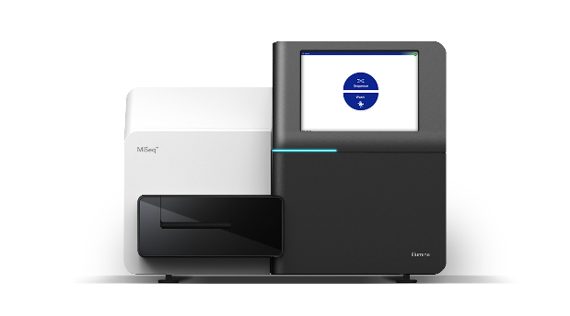
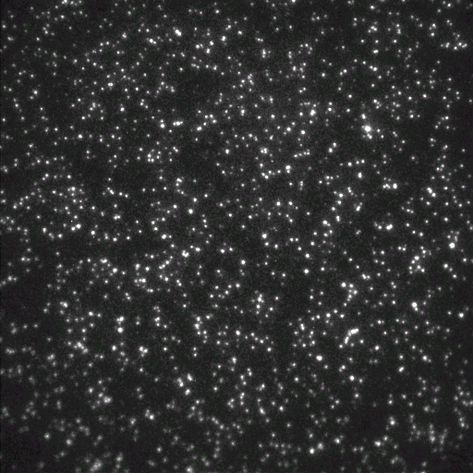
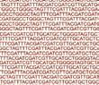


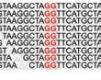



Analysis Overview
Analysis Type | Software | Outputs
Control Software
Analysis Software
Visualization Software
Images, Intensities and Base Calls
Alignments, Variant Detection
Annotation, Filtering, Reports

Slide 39

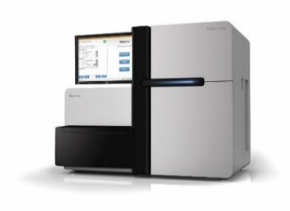

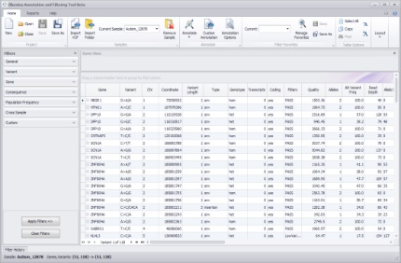



Analysis and Interpretation of Sequencing Data Data in, biological knowledge out
Public Databases & Private Data Centres
Sequencing Data
Export Annotated/ Filtered Variants
Data Analysis
For Research Use Only. Not for use in diagnostic procedures.

Slide 40
Illumina Systems
3

Slide 41
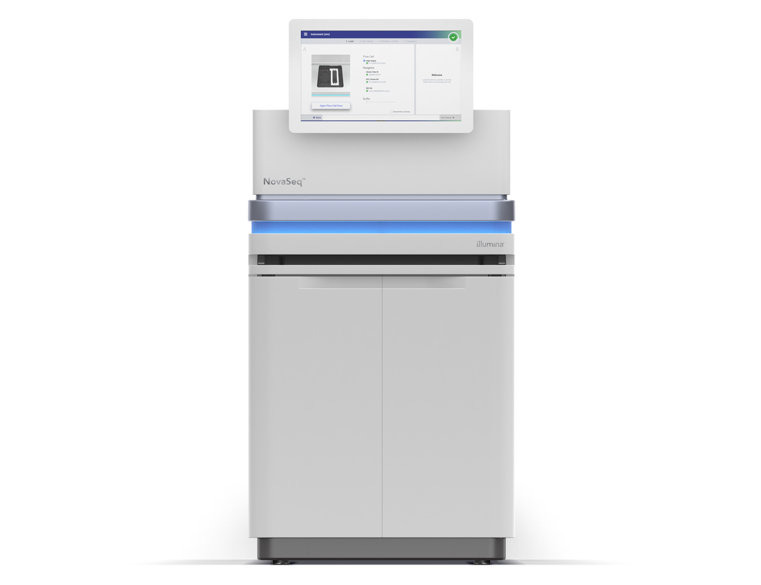






Illumina System Benefits
Fast turnaround for time-critical projects
Integrates cluster generation and sequencing in ONE system
Simple workflow for limited impact to lab overhead
Integrates with Illumina library prep and informatics
Notes:
Quá trình giải trình tự diễn ra hoàn toàn tự động. Tất cả hệ thống GTT của ILMN đều có tích hợp quá trình tạo cluster và giải trình tự trên cùng 1 hệ thống
Chất lượng dữ liệu đều đạt > Q30

Slide 42








Sequencing Power for Every Scale
NovaSeq X
16000Gb | 52B | 2x150
Key Takeaway:
NovaSeq 6000
NextSeq™ 1k/2k
6000Gb | 20B | 2x150
Greater than 20,000 sequencers shipped globally
Increasing system price & output
330Gb* | 1.1B* | 2x150
NextSeq™ 550
120Gb | 400M | 2x150
300,000 peer-reviewed publications, 5x vs. all other participants*
MiSeq™
15Gb | 25M | 2x300
MiniSeq™
7.5 Gb | 25M | 2x150
iSeq™ 100
1.2 Gb | 4M | 2x150
Decreasing price per Gb
*Data on file
Notes:
“Although NovaSeq X is our newest, most powerful sequencer to date, it is part of a larger family of RUO platforms that are built to serve the needs across the output and budget spectrum of our wide customer base. To date, we’ve shipped more than 20,000 sequencers globally, which have been used to generate data in more than 300,000 peer-reviewed publications. This is 5X the number of publications of all other market participants combined, showing Illumina as a trusted provider of genomic sequencing solutions.”
Regional trainings will talk about positioning NVSQ X, NVSQ 6K, and NVSQ Dx
Paired end reads, massive service and support team, robust quality and manufacturing

Slide 43





FDA-regulated, CE-IVD marked Sequencer
Illumina is the leading provider of NGS IVD solutions, with three Dx platforms currently on the market and a growing menu of IVD tests
NovaSeqDx will be a fit-for-purpose clinical instrument that is designed to run IVD assays, developed either by Illumina or our partners.
It will also function as an open platform system, which allows development of IVD assays for site specific use or for distribution.
From left to right:
MiSeqDx, NovaSeqDx, NextSeq 550Dx

Slide 44



Application By Sequencer
Amount of Data | Sequencer | Applications
Most Least | NovaSeq™ 6000 NovaSeq X series | Whole Genome, Transcriptome, Methylome, Liquid Biopsy
 |  | Single cells, Trios, Exomes, Enrichment
 | NextSeq™ 2000
 | NextSeq™ 550 | NIPT, Oncology Panels, Small Genomes, Enrichment
 | MiSeq™ | Oncology Panels, PGT-A (For MiSeq only), Small RNA, Targeted Panels , Metagenomics Amplicon, Bacterial WGS
 | MiniSeq™
 | iSeq™ 100

Slide 45


ĐỐI TÁC CHIẾN LƯỢC
Biomedic JSC., đã và đang là nhà phân phối độc quyền của Illumina Inc., tại thị trường Việt Nam kể từ năm 2011
Năm 2018 – 2021, Biomedic JSC., tự hào được vinh danh là Global Elite Channel Partner của Illumina Inc.,

Slide 46









Số đầu máy NGS/ Scan Biomedic phục vụ
NovaSeq™ 6000
NextSeq™ 1000/2000
NextSeq™ 550
MiSeq™
02
03
07
40
MiniSeq™
iSeq™ 100
NextSeq™ 550Dx*
MiSeq™ Dx*
06
05
03
06
Array Scanners
iScan™ System
02
> 70 hệ thống máy NGS, server phân tích đã được cài đặt trên toàn quốc
Notes:
Update tháng 3/2021

Slide 47

CUNG CẤP GIẢI PHÁP TOÀN DIỆN
Simplified library prep
Custom content
Flexible, economical sequencing
Integrated analysis

Slide 48


Slide 49


Slide 50
TRÂN TRỌNG CẢM ƠN!
MBA.Nguyễn Thuỳ Quốc Hương - 0966.777.188
Email: huongntq@biomedic.com.vn

